Slide 1
Big O
David Kauchak
cs140
Spring 2024

Slide 2
Administrative
Assignment 0 out and due on Sunday
Mentor hours up soon!
Slack channel

Slide 3
Proofs
What is a proof?
A deductive argument showing a statement is true based on previous knowledge (axioms)
Why are they important/useful?
Allows us to be sure that something is true.
In algorithms: allow us to prove properties of algorithms.

Slide 4
An example
Prove the sum of two odd integers is even

Slide 5
An example
Prove the sum of two odd integers is even
Odd number: n = 2k + 1 for some integer k
Even number: n = 2k for some integer k

Slide 6
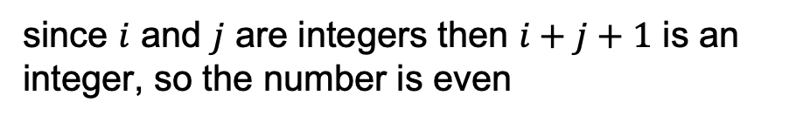




An example
Prove the sum of two odd integers is even
Odd number: n = 2k + 1 for some integer k
Even number: n = 2k for some integer k
Let $a$ and $b$ be odd numbers
By definition: $a = 2i+1$and $b = 2j+1$ where $i$ and $j$ are integers
$$a+b = 2i+1+2j+1$$
$$= 2i+2j+2$$
$$= 2(i+j+1)$$
since $i$ and $j$ are integers then $i+j+1$ is an integer, so the number is even

Slide 7
Proof techniques?
example/counterexample
enumeration
by cases
by inference (aka direct proof)
trivially
contrapositive
contradiction
induction (strong and weak)

Slide 8
Proof by induction (weak)
Proving something about a sequence of events by:
first: proving that some starting case is true and
then: proving that if a given event in the sequence were true then the next event would be true

Slide 9
Proof by induction (weak)
Base case: prove some starting case is true
Inductive case: Assume some event is true and prove the next event is true
Inductive hypothesis: Assume the event is true (usually k or k-1)
Inductive step to prove: What you’re trying to prove assuming the inductive hypothesis is true
Proof of inductive step

Slide 10
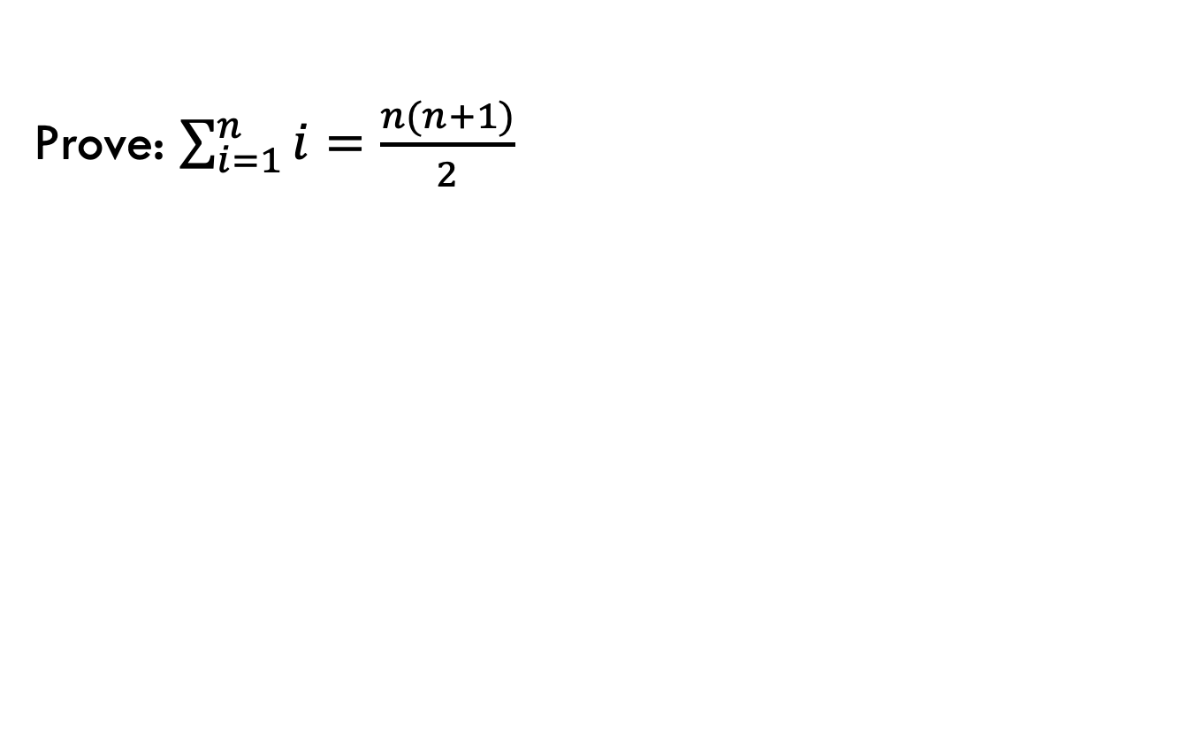
Proof by induction example
Prove: $\sum_{i=1}^{n}{i=\frac{n(n+1)}{2}}$
Base case: prove some starting case is true
Inductive case: Assume some event is true and prove the next event is true
Inductive hypothesis: Assume the event is true (usually k or k-1)
Inductive step to prove: What you’re trying to prove assuming the inductive hypothesis is true
Proof of inductive step

Slide 11
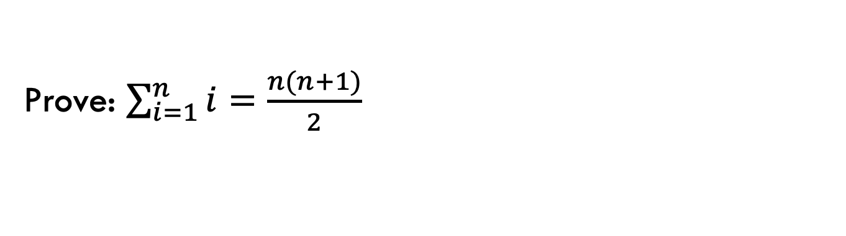
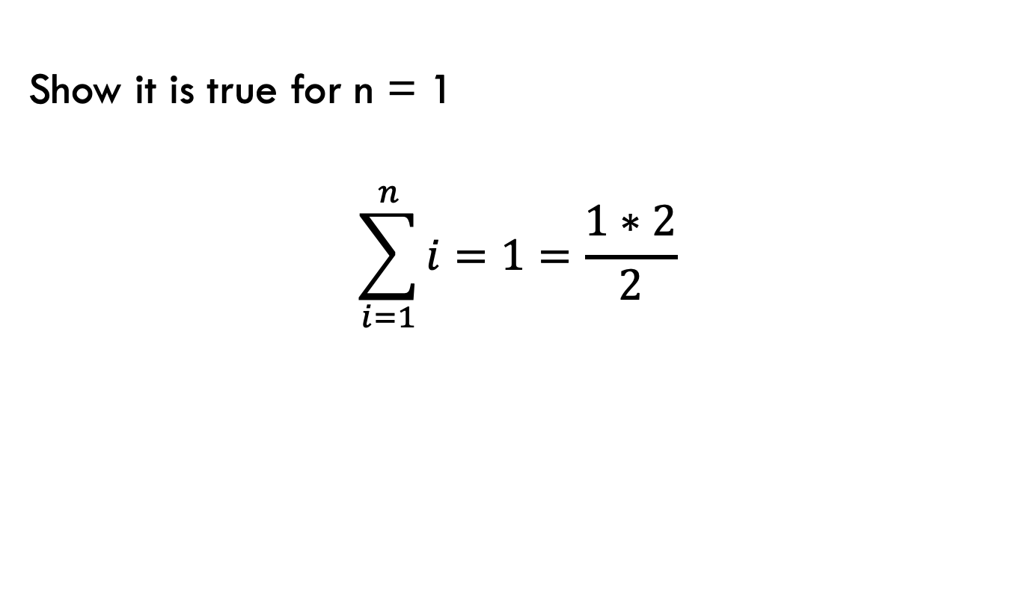
Base case
Prove: $\sum_{i=1}^{n}{i=\frac{n(n+1)}{2}}$
Show it is true for n = 1
$$\sum_{i=1}^{n}{i}=1=\frac{1∗2}{2}$$

Slide 12
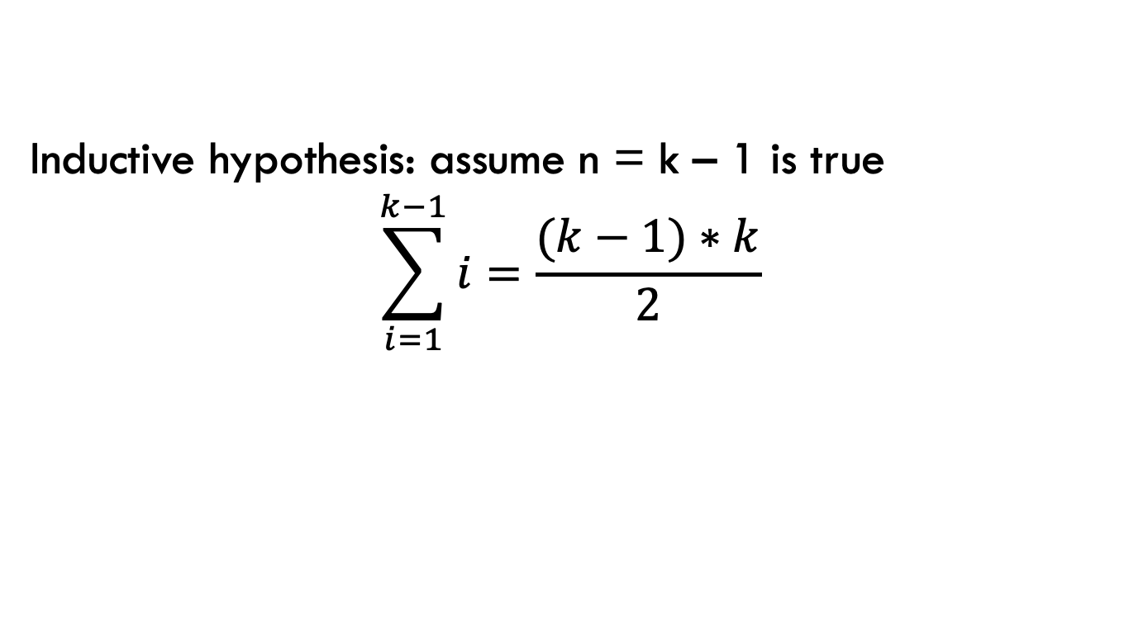
Inductive case
Prove: $\sum_{i=1}^{n}{i=\frac{n(n+1)}{2}}$
Inductive hypothesis: assume n = k – 1 is true
$$\sum_{i=1}^{k−1}{i}=\frac{(k−1)∗k}{2}$$

Slide 13
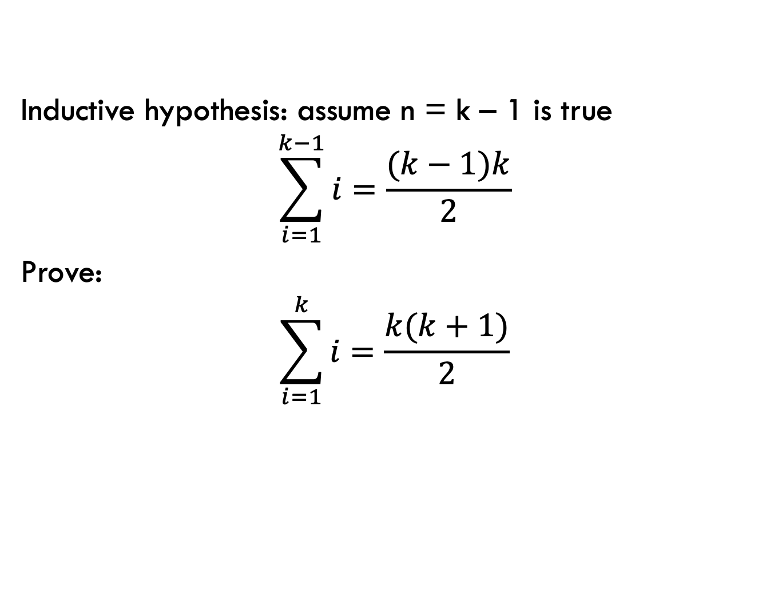
Inductive case
Prove: $\sum_{i=1}^{n}{i=\frac{n(n+1)}{2}}$
Inductive hypothesis: assume n = k – 1 is true
$$\sum_{i=1}^{k−1}{i}=\frac{(k−1)k}{2}$$
Prove:
$$\sum_{i=1}^{k}{i}=\frac{k(k+1)}{2}$$

Slide 14
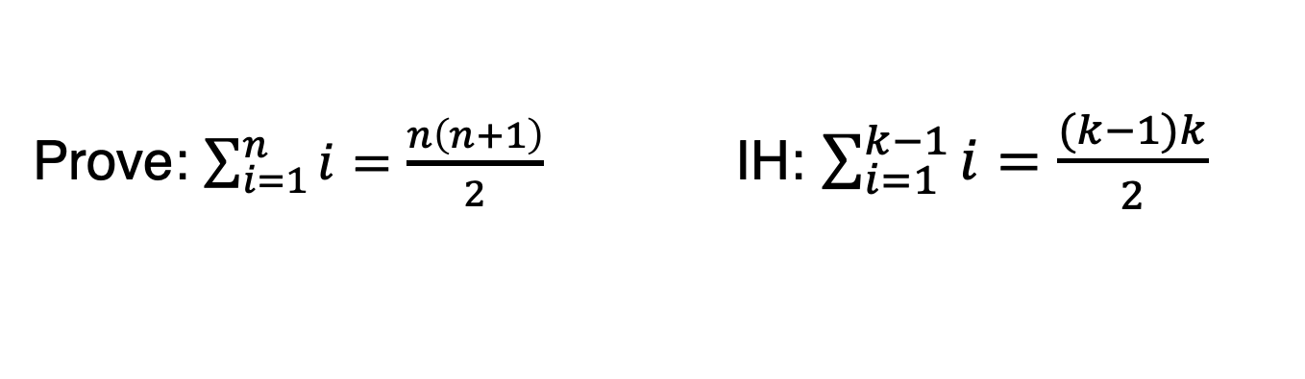
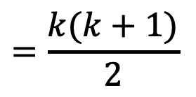
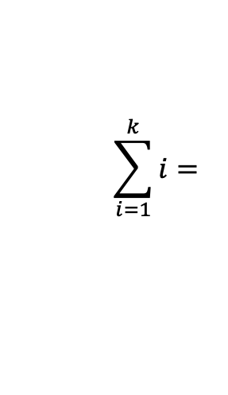
Inductive case: proof
Prove: $\sum_{i=1}^{n}{i=\frac{n\left(n+1\right)}{2}}$ IH: $\sum_{i=1}^{k−1}{i}=\frac{(k−1)k}{2}$
$$\sum_{i=1}^{k}{i}=$$
$$=\frac{k(k+1)}{2}$$

Slide 15


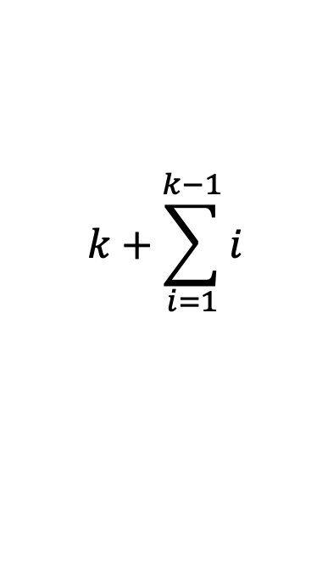
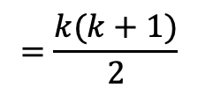


Inductive case: proof
Prove: $\sum_{i=1}^{n}{i=\frac{n\left(n+1\right)}{2}}$ IH: $\sum_{i=1}^{k−1}{i}=\frac{(k−1)k}{2}$
$$\sum_{i=1}^{k}{i}=$$
$$k+\sum_{i=1}^{k−1}{i}$$
by definition of sum
$=k+$ $\frac{(k−1)∗k}{2}$
by IH
$=\frac{2k}{2}+$ $\frac{(k−1)∗k}{2}$
$=$ $\frac{2k+ (k−1)∗k}{2}$
Why does induction work as a proof?
$=$ $\frac{k2+k}{2}$
$$=\frac{k(k+1)}{2}$$

Slide 16
Layout of a proof by induction
State what you’re trying to prove We show that XXX using proof by induction
Prove base case
State the inductive hypothesis
Inductive proof
State what you want to show (may include a variable change, e.g., k in instead of n)
Show a step-by-step derivation from the left-hand side resulting in the right-hand side. Give justifications for steps that are non-trivial

Slide 17
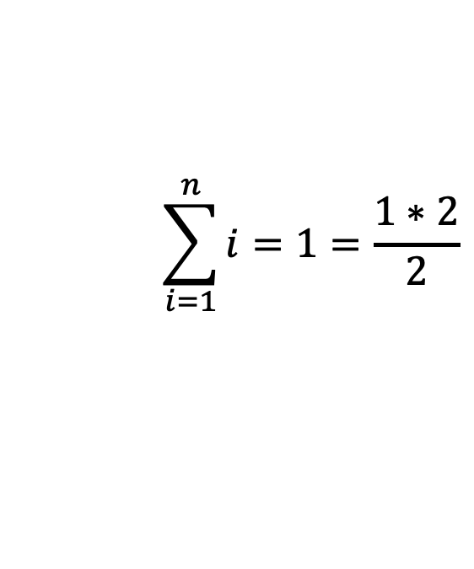
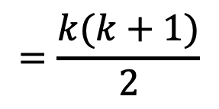
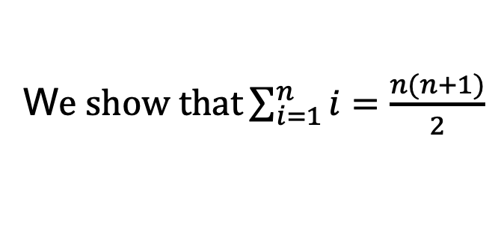
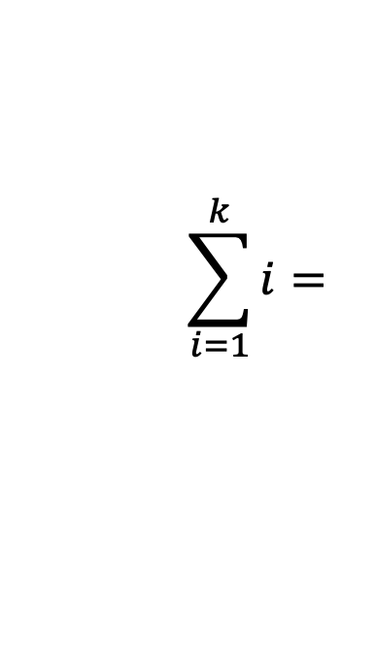
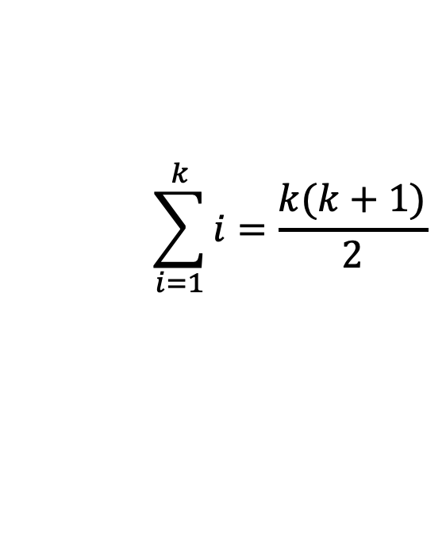
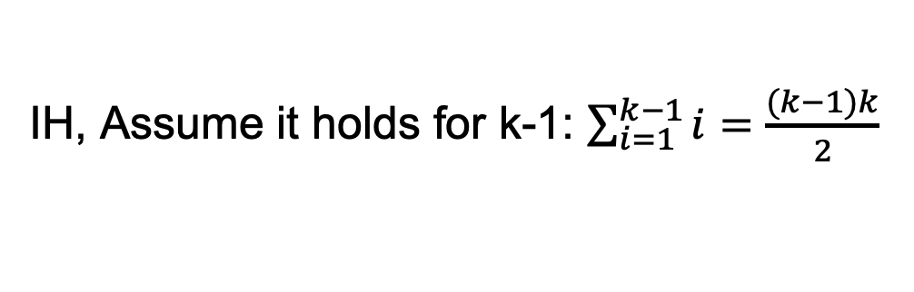
1.
W$e show that\sum_{i=1}^{n}{i=\frac{n(n+1)}{2}}$
using proof by induction
2.
Base case: n = 1
$$\sum_{i=1}^{n}{i}=1=\frac{1∗2}{2}$$
3.
IH, Assume it holds for k-1: $\sum_{i=1}^{k−1}{i}=\frac{(k−1)k}{2}$
$$\sum_{i=1}^{k}{i}=\frac{k(k+1)}{2}$$
4.
Inductive step: want to show
$$\sum_{i=1}^{k}{i}=$$
…
$$=\frac{k(k+1)}{2}$$

Slide 18
Inductive proofs
Weak vs. strong?

Slide 19
Inductive proofs
Weak: inductive hypothesis only assumes it holds for some step (e.g., kth step)
Strong: inductive hypothesis assumes it holds for all steps from the base case up to k

Slide 20

Sorting
Input: An array of numbers A
Output: The number in sorted order, i.e.,

Slide 21
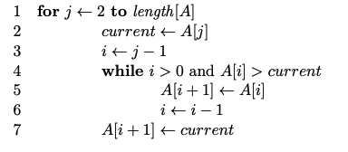
Sorting
What sorting algorithm?

Slide 22
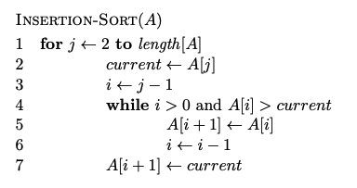
Sorting

Slide 23
Does it terminate?
Is it correct?
How long does it take to run?
Memory usage?

Slide 24
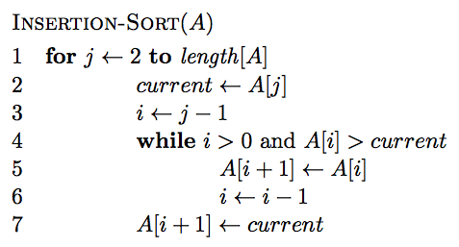
Insertion-sort
Does it terminate?

Slide 25
Insertion-sort
Is it correct? Can you prove it?

Slide 26
Loop invariant
Loop invariant: A statement about a loop that is true before the loop begins and after each iteration of the loop.
Upon termination of the loop, the invariant should help you show something useful about the algorithm.
Loop invariant?

Slide 27
Loop invariant
Loop invariant: A statement about a loop that is true before the loop begins and after each iteration of the loop.
At the start of each iteration of the for loop of lines 1-7 the subarray A[1..j − 1] is the sorted version of the original elements of A[1..j − 1]
Proof?

Slide 28
Loop invariant
At the start of each iteration of the for loop of lines 1-7 the subarray A[1..j − 1] is the sorted version of the original elements of A[1..j − 1]
Proof by induction - Base case: invariant is true before loop
- Inductive case: it is true after each iteration

Slide 29
Insertion-sort
How long will it take to run?

Slide 30
Asymptotic notation
How do you answer the question: “what is the running time of algorithm x?”
We want to talk about the computational cost of an algorithm that focuses on the essential parts and ignores irrelevant details
You’ve seen some of this already:
linear
n log n
n²

Slide 31
Asymptotic notation
Precisely calculating the actual steps is tedious and not generally useful
Different operations take different amounts of time. Even from run to run, things such as caching, etc. cause variations
We want to identify categories of algorithmic runtimes

Slide 32
For example…
f₁(n) takes n² steps
f₂(n) takes 2n + 100 steps
f₃(n) takes 3n+1 steps
Which algorithm is better?
Is the difference between f₂ and f₃ important/significant?

Slide 33
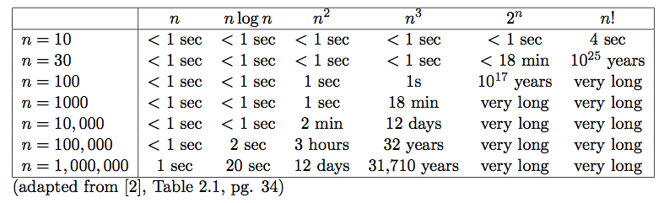
Runtime examples

Slide 34
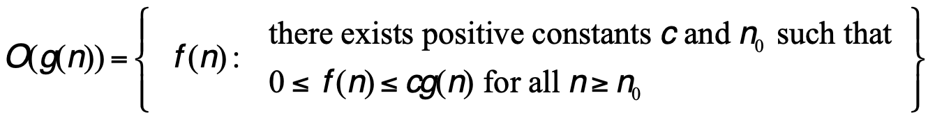
Big O: Upper bound
O(g(n)) is the set of functions:

Slide 35
Big O: Upper bound
O(g(n)) is the set of functions:
We can bound the function f(n) above by some constant factor of g(n)

Slide 36
Big O: Upper bound
O(g(n)) is the set of functions:
We can bound the function f(n) above by some constant multiplied by g(n)
For some increasing range

Slide 37
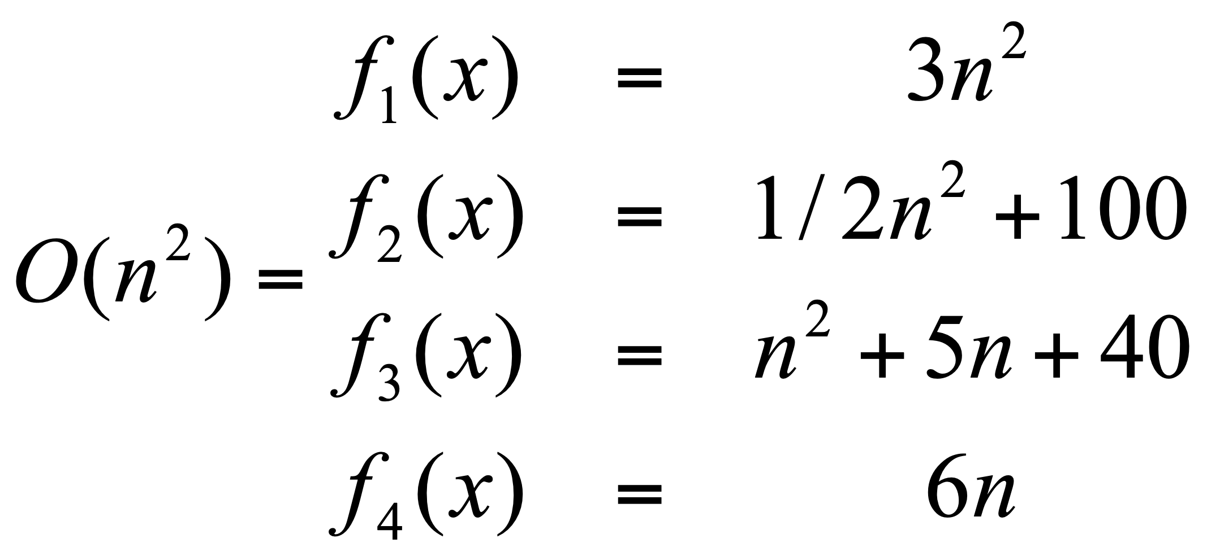
Big O: Upper bound
O(g(n)) is the set of functions:

Slide 38
Big O: Upper bound
O(g(n)) is the set of functions:
Generally, we’re most interested in big O notation since it is an upper bound on the running time

Slide 39
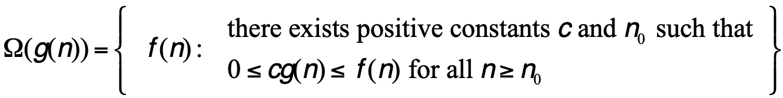
Omega: Lower bound
Ω(g(n)) is the set of functions:

Slide 40
Omega: Lower bound
Ω(g(n)) is the set of functions:
We can bound the function f(n) below by some constant factor of g(n)

Slide 41
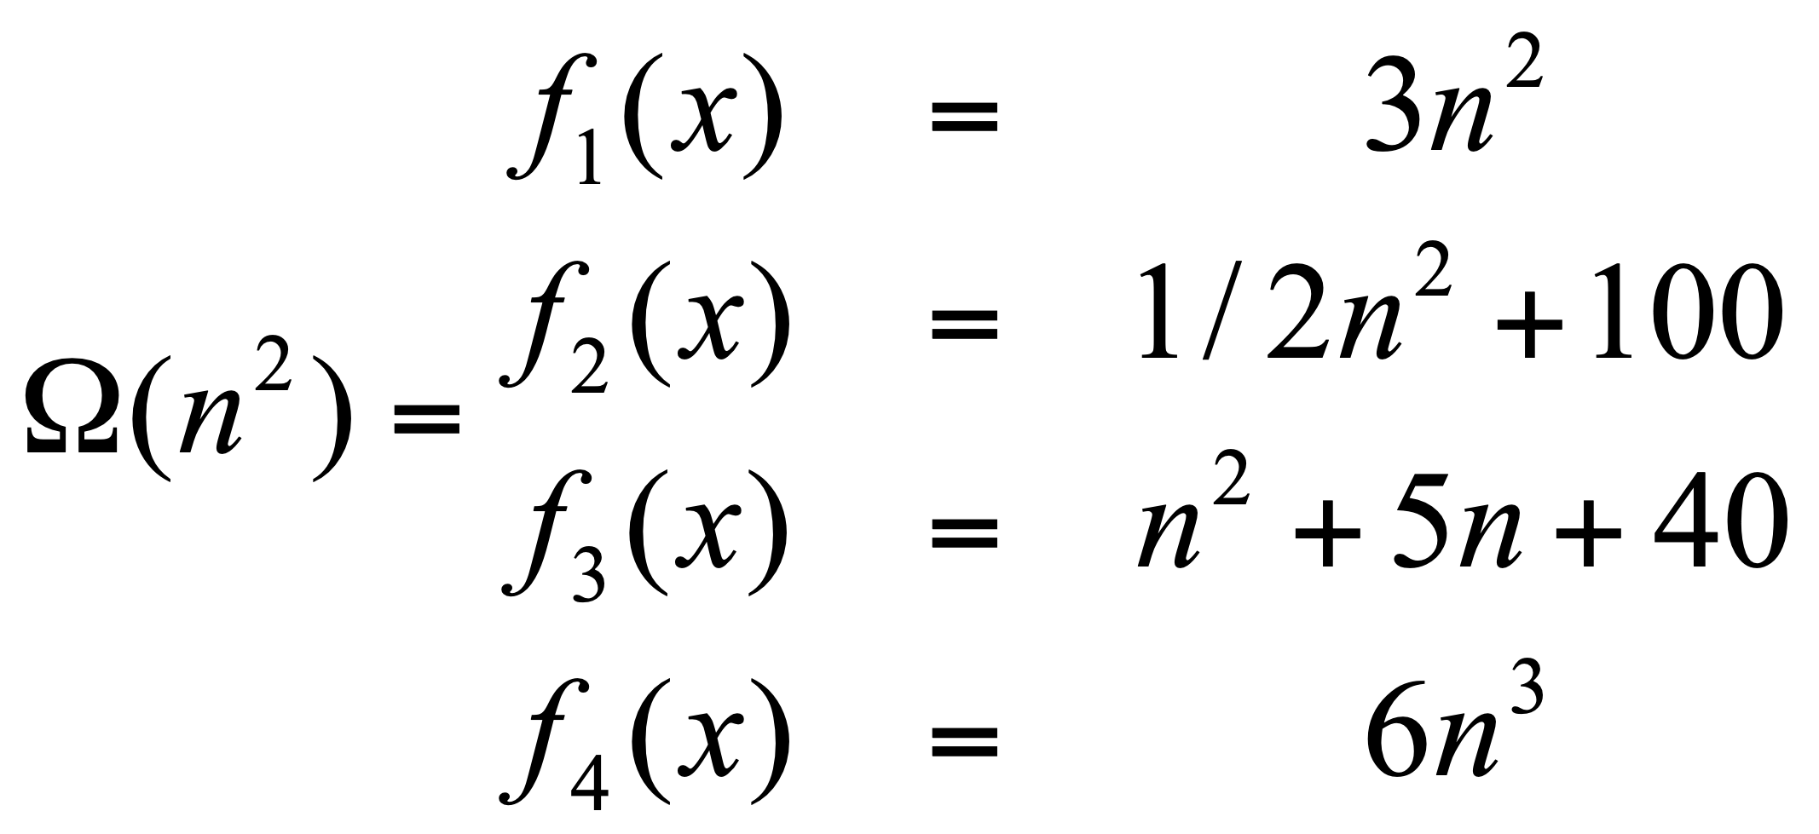
Omega: Lower bound
Ω(g(n)) is the set of functions:

Slide 42
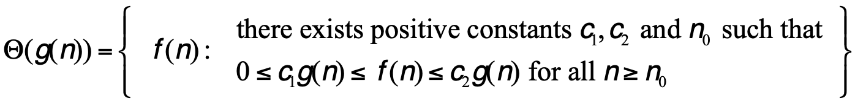
Theta: Upper and lower bound
Θ(g(n)) is the set of functions:

Slide 43
Theta: Upper and lower bound
Θ(g(n)) is the set of functions:
We can bound the function f(n) above and below by some constant factor of g(n) (though different constants)

Slide 44
Theta: Upper and lower bound
Θ(g(n)) is the set of functions:
Note: A function is theta bounded iff it is big O bounded and Omega bounded

Slide 45
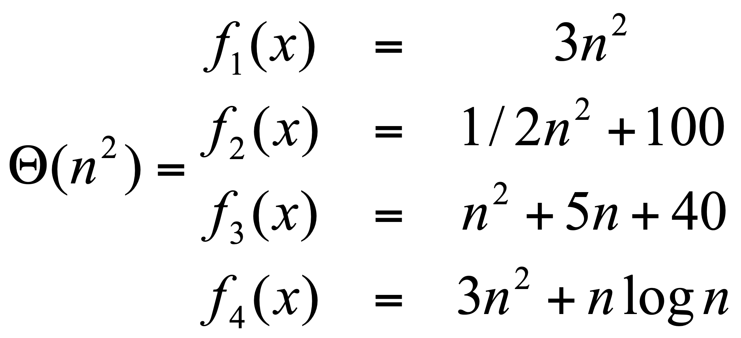

Theta: Upper and lower bound
$Θ(g(n))$ is the set of functions:

Slide 46
Visually
f(n)

Slide 47
Visually: upper bound
f(n)
n₀

Slide 48
Visually: lower bound
f(n)
n₀

Slide 49
worst-case vs. best-case vs. overall
worst-case: what is the worst the running time of the algorithm can be?
best-case: what is the best the running time of the algorithm can be?
overall: given some data, what is the running time of the algorithm? (Sometimes can think about this as any data or random data)
Don’t confuse this with O, Ω and Θ. The cases above are situations, asymptotic notation is about bounding particular situations

Slide 50
Some rules of thumb
Multiplicative constants can be omitted
14n² becomes n²
7 log n become log n
Lower order functions can be omitted
n + 5 becomes n
n² + n becomes n²
nª dominates n^{b} if a > b
n² dominates n, so n²+n becomes n²
n^{1.5} dominates n^{1.4}

Slide 51
Some rules of thumb
a^{n} dominates b^{n} if a > b
3^{n} dominates 2^{n}
Any exponential dominates any polynomial
3^{n} dominates n⁵
2^{n} dominates n^{c}
Any polynomial dominates any logarithm
n dominates log n or log log n
n² dominates n log n
n^{1/2} dominates log n
Do not omit lower order terms of different variables (n² + m) does not become n²

Slide 52
Big O
n² + n log n + 50
2^{n} -15n² + n³ log n
n^{log n} + n² + 15n³
n⁵ + n! + n^{n}

Slide 53
Insertion-sort
How long will it take to run?

Slide 54
Insertion-sort
How long will it take to run?
Best case? Worst case? Overall?
Use theta when you can, O otherwise.

Slide 55
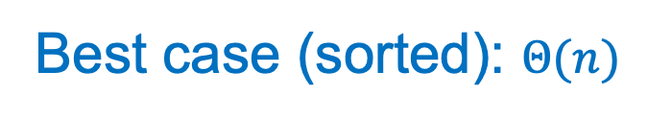
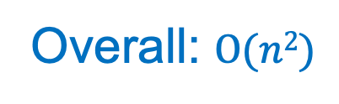
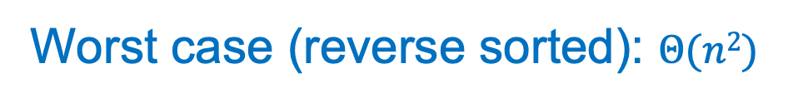
Insertion-sort
Best case (sorted): $Θ(n)$
Worst case (reverse sorted): $Θ(n2)$
Overall: $O(n2)$

Slide 56
Some examples
O(1) – constant. Fixed amount of work, regardless of the input size
add two 32-bit numbers
determine if a number is even or odd
sum the first 20 elements of an array
delete an element from a doubly linked list
O(log n) – logarithmic. At each iteration, discards some portion of the input (i.e., half)
binary search

Slide 57
Some examples
O(n) – linear. Do a constant amount of work on each element of the input
find an item in a linked list
determine the largest element in an array
O(n log n) log-linear. Divide and conquer algorithms with a linear amount of work to recombine
Sort a list of number with MergeSort
FFT

Slide 58
Some examples
O(n²) – quadratic. Double nested loops that iterate over the data
Insertion sort
O(2^{n}) – exponential
Enumerate all possible subsets
Traveling salesman using dynamic programming
O(n!)
Enumerate all permutations
determinant of a matrix with expansion by minors

